Slide 1


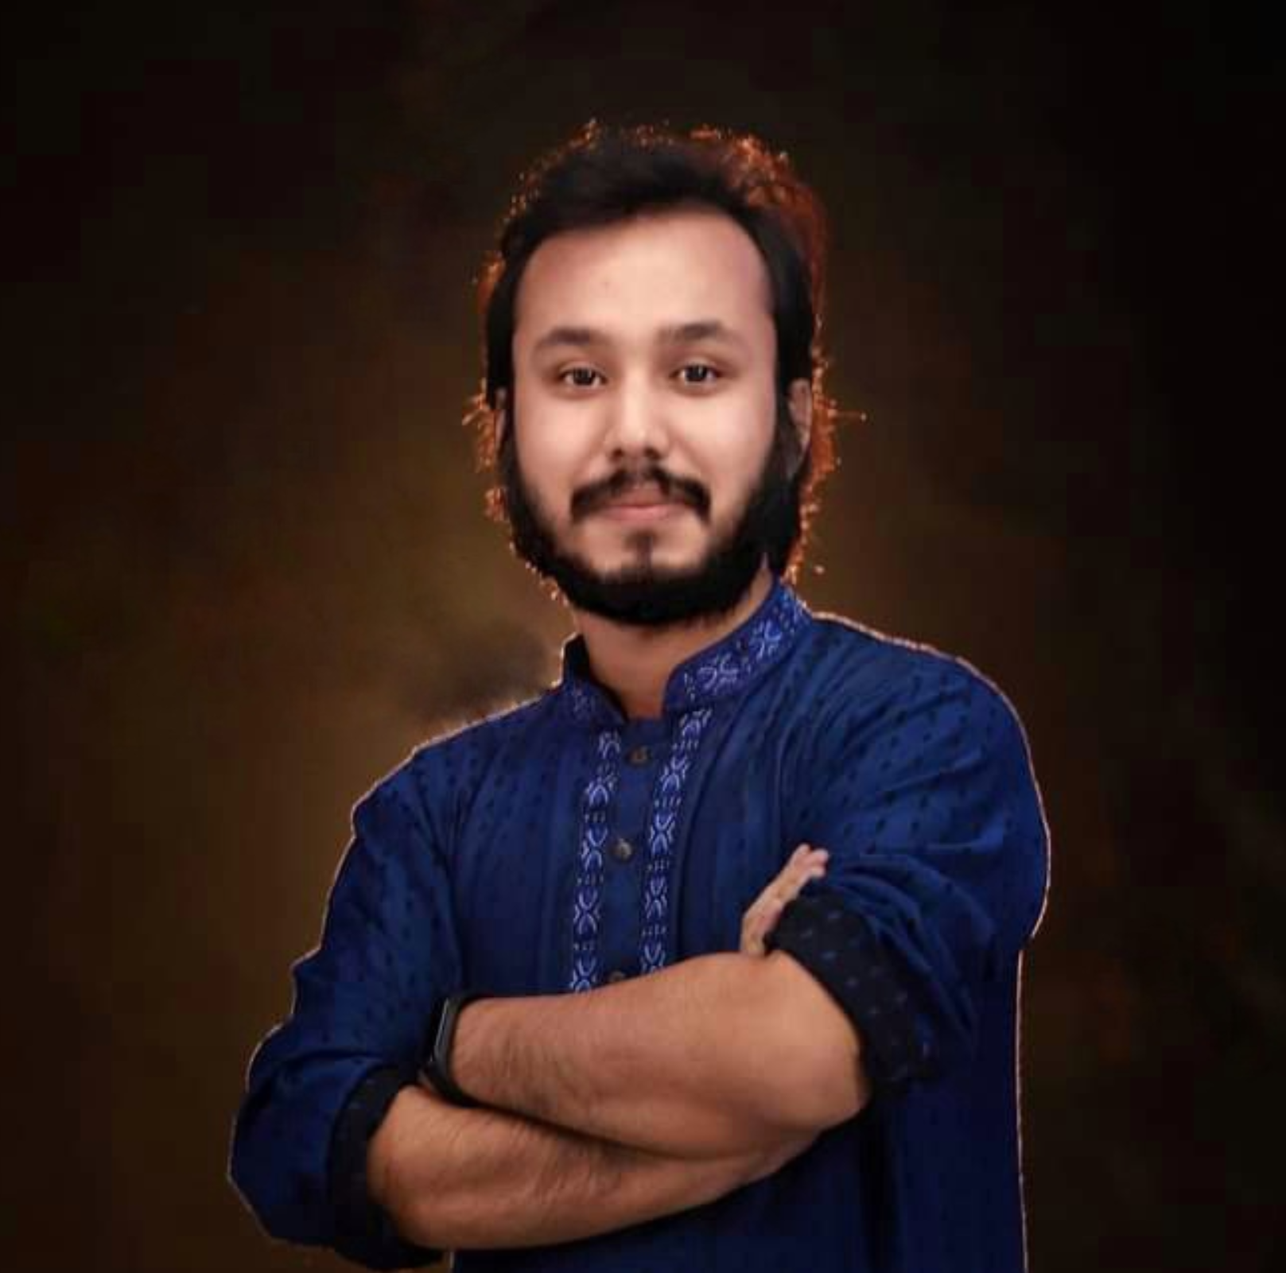
HSC’23 ICT free online class.
আই সি টি বইয়ের পূর্নাঙ্গ প্রিপারেশন
৬ টি অধ্যায়ের পড়া, MCQ, সৃজনশীল
কৌশিক রায়
Studying MSc in Computer Science (PMSCS)
Jahangirnagar University
#Dadar Class – দাদার ক্লাস

Slide 2
৩য় অধ্যায় (ক) ১ম অংশ
সংখ্যা পদ্ধতি
HSC ICT Full Book Preparation Online Class with Kowshique Roy

Slide 3

HSC ICT Full Book Preparation Online Class with Kowshique Roy

Slide 4

HSC ICT Full Book Preparation Online Class with Kowshique Roy

Slide 5

HSC ICT Full Book Preparation Online Class with Kowshique Roy

Slide 6

HSC ICT Full Book Preparation Online Class with Kowshique Roy

Slide 7

HSC ICT Full Book Preparation Online Class with Kowshique Roy

Slide 8

HSC ICT Full Book Preparation Online Class with Kowshique Roy

Slide 9

HSC ICT Full Book Preparation Online Class with Kowshique Roy

Slide 10
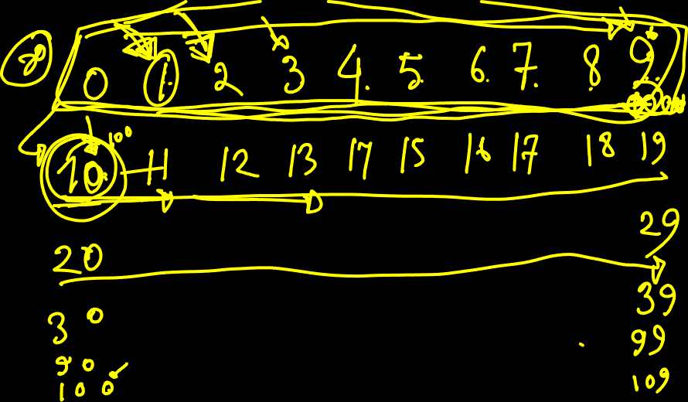
HSC ICT Full Book Preparation Online Class with Kowshique Roy

Slide 11

HSC ICT Full Book Preparation Online Class with Kowshique Roy

Slide 12
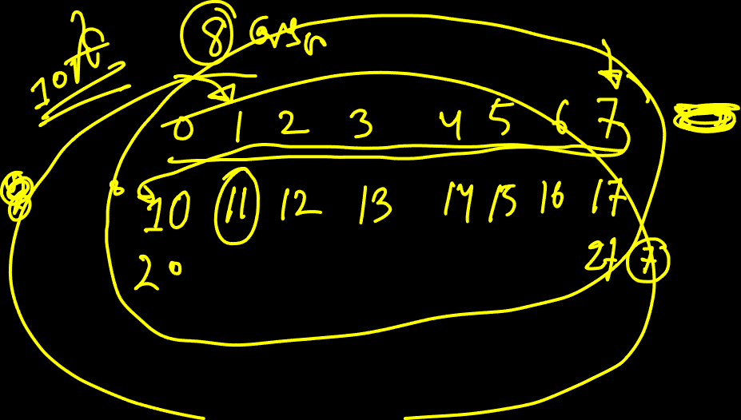
HSC ICT Full Book Preparation Online Class with Kowshique Roy

Slide 13

HSC ICT Full Book Preparation Online Class with Kowshique Roy

Slide 14

HSC ICT Full Book Preparation Online Class with Kowshique Roy

Slide 15

HSC ICT Full Book Preparation Online Class with Kowshique Roy

Slide 16

HSC ICT Full Book Preparation Online Class with Kowshique Roy

Slide 17

HSC ICT Full Book Preparation Online Class with Kowshique Roy

Slide 18

HSC ICT Full Book Preparation Online Class with Kowshique Roy

Slide 19

HSC ICT Full Book Preparation Online Class with Kowshique Roy

Slide 20

HSC ICT Full Book Preparation Online Class with Kowshique Roy

Slide 21

HSC ICT Full Book Preparation Online Class with Kowshique Roy

Slide 22

HSC ICT Full Book Preparation Online Class with Kowshique Roy

Slide 23

HSC ICT Full Book Preparation Online Class with Kowshique Roy

Slide 24
HSC ICT Full Book Preparation Online Class with Kowshique Roy

Slide 25
HSC ICT Full Book Preparation Online Class with Kowshique Roy

Slide 26
HSC ICT Full Book Preparation Online Class with Kowshique Roy

Slide 27
HSC ICT Full Book Preparation Online Class with Kowshique Roy

Slide 28
HSC ICT Full Book Preparation Online Class with Kowshique Roy

Slide 29
HSC ICT Full Book Preparation Online Class with Kowshique Roy

Slide 30
HSC ICT Full Book Preparation Online Class with Kowshique Roy

Slide 31
HSC ICT Full Book Preparation Online Class with Kowshique Roy

Slide 32
HSC ICT Full Book Preparation Online Class with Kowshique Roy

Slide 33
HSC ICT Full Book Preparation Online Class with Kowshique Roy

Slide 34
HSC ICT Full Book Preparation Online Class with Kowshique Roy

Slide 35
HSC ICT Full Book Preparation Online Class with Kowshique Roy

Slide 36
HSC ICT Full Book Preparation Online Class with Kowshique Roy

Slide 37
HSC ICT Full Book Preparation Online Class with Kowshique Roy

Slide 38
HSC ICT Full Book Preparation Online Class with Kowshique Roy

Slide 39
HSC ICT Full Book Preparation Online Class with Kowshique Roy

Slide 40
HSC ICT Full Book Preparation Online Class with Kowshique Roy

Slide 41
HSC ICT Full Book Preparation Online Class with Kowshique Roy

Slide 42
HSC ICT Full Book Preparation Online Class with Kowshique Roy

Slide 43
HSC ICT Full Book Preparation Online Class with Kowshique Roy

Slide 44
HSC ICT Full Book Preparation Online Class with Kowshique Roy

Slide 45
HSC ICT Full Book Preparation Online Class with Kowshique Roy

Slide 46
HSC ICT Full Book Preparation Online Class with Kowshique Roy

Slide 47
HSC ICT Full Book Preparation Online Class with Kowshique Roy

Slide 48
HSC ICT Full Book Preparation Online Class with Kowshique Roy

Slide 49
HSC ICT Full Book Preparation Online Class with Kowshique Roy

Slide 50
প্রশ্ন?
HSC ICT Full Book Preparation Online Class with Kowshique Roy

